Slide 1
US Census Bureau NIEM Statistics Domain Status Update
NIEM 2018 Face-to-Face Meeting
October 29th, 2018
Christopher Carrino
Chief Data Architect
US Census Bureau

Slide 2
The Survey Life Cycle
}
01
Survey Design
02
Frame Development
03
04
05
06
07
08
Instrument Development
Sample Design and Implementation
Data Collection
Data Editing, Imputation, & Estimation
Data Review, Analysis & Correction
Data Products & Dissemination
More Metadata
Effort Here
will
result
in
}
Less Effort Here

Slide 3
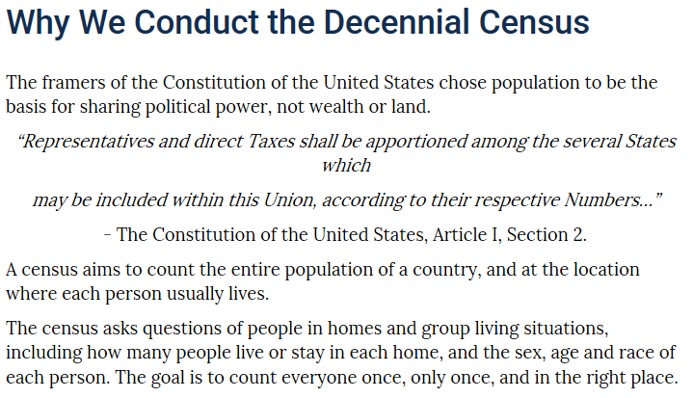

Slide 4
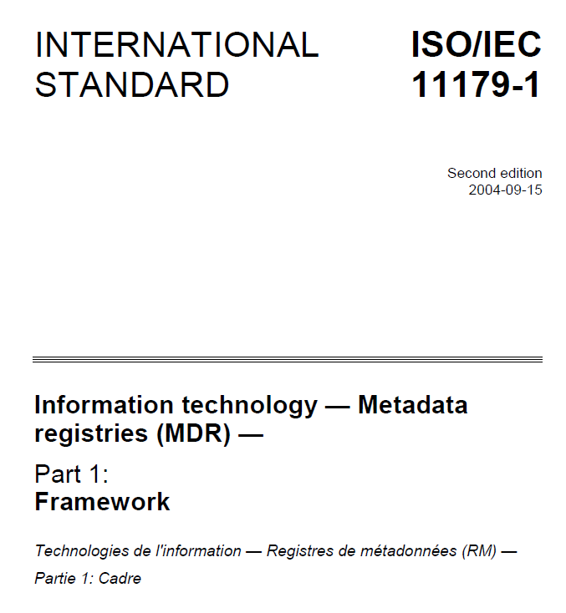
ISO 11179

Slide 5
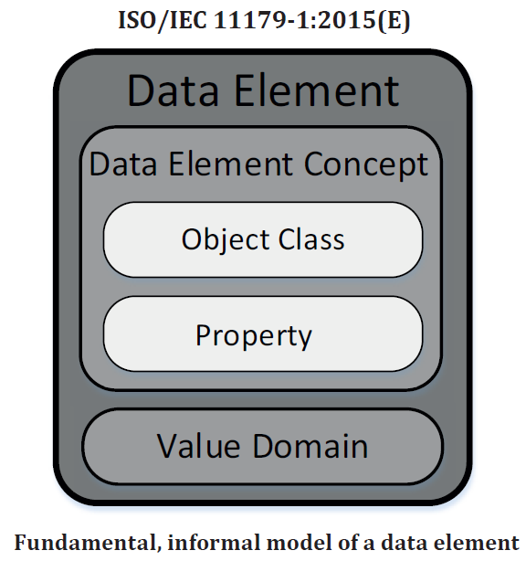

Slide 6
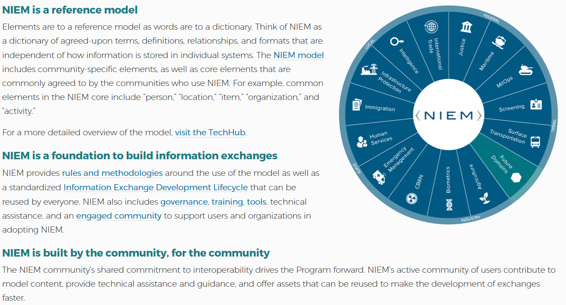
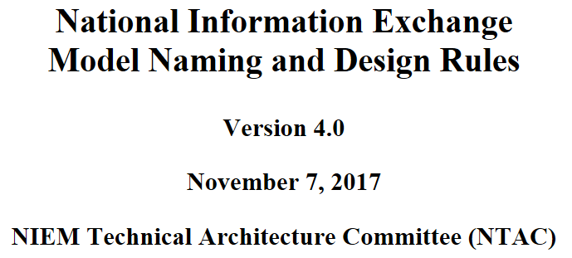
National Information Exchange Model (NIEM)

Slide 7
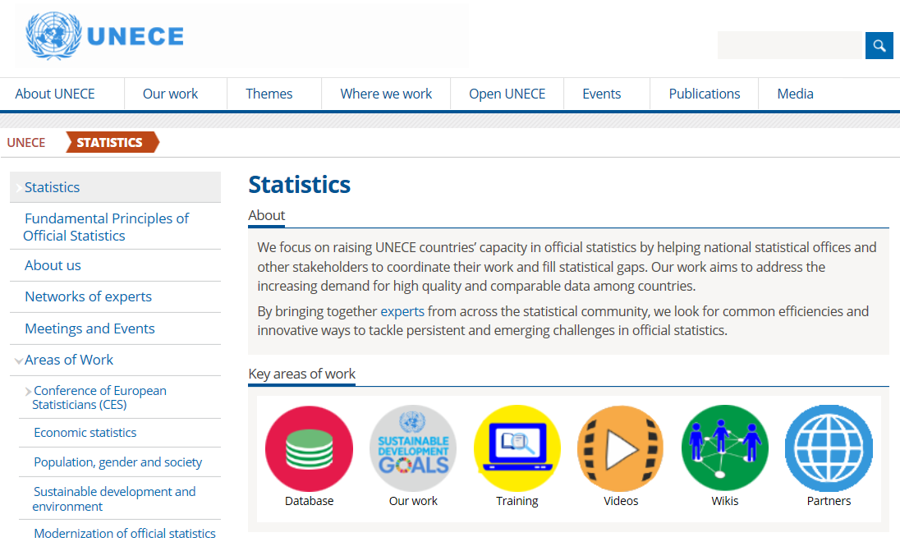
International Statistical Community

Slide 8
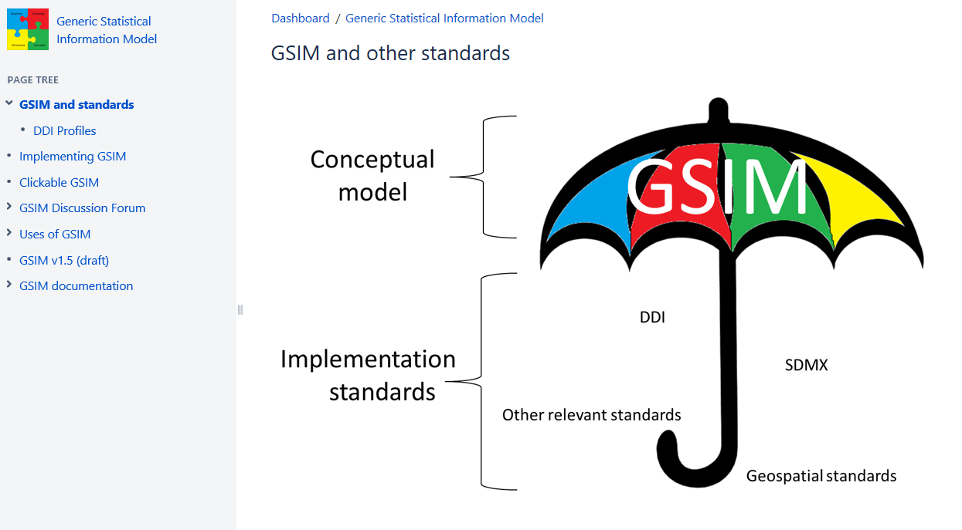
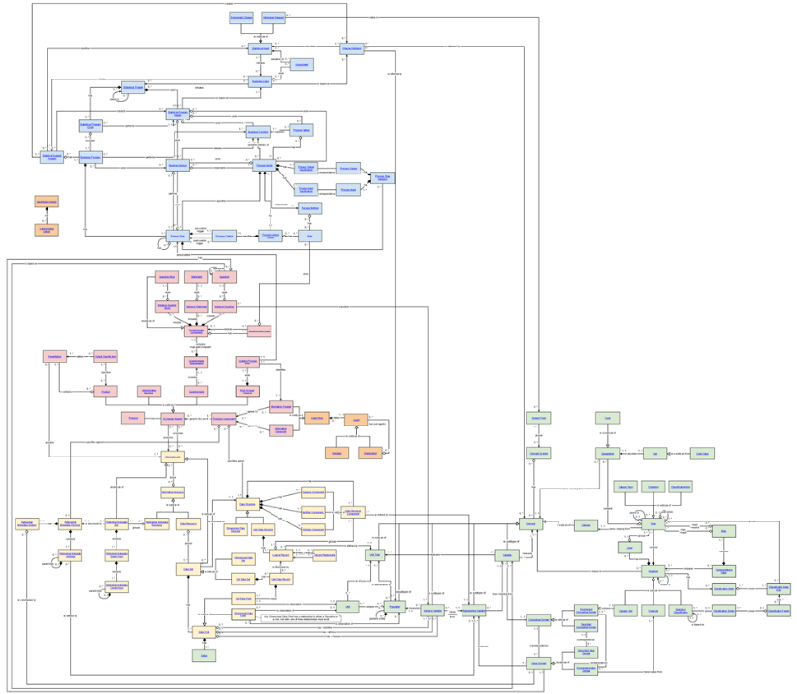
Generic Statistical Information Model (GSIM)

Slide 9
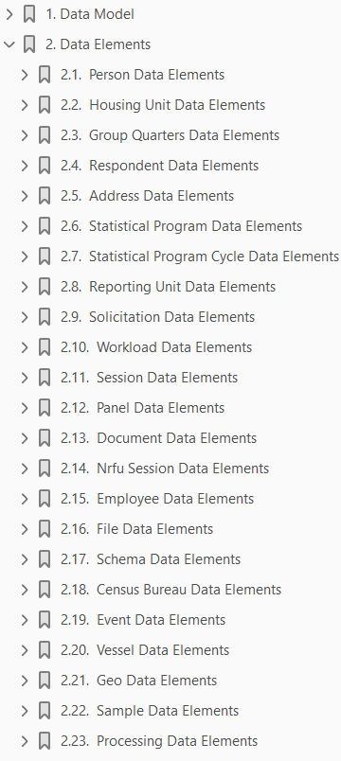
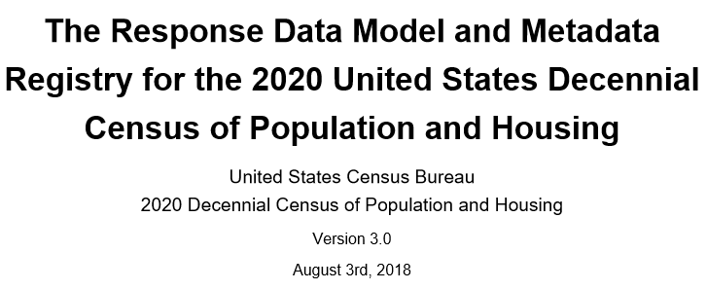

Slide 10
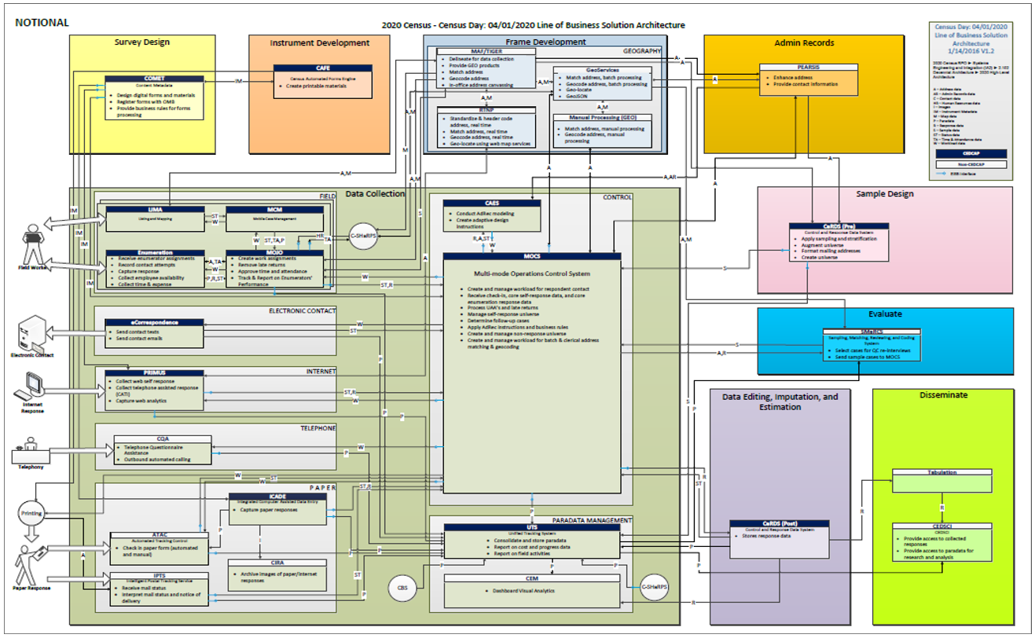
Census System of Systems

Slide 11
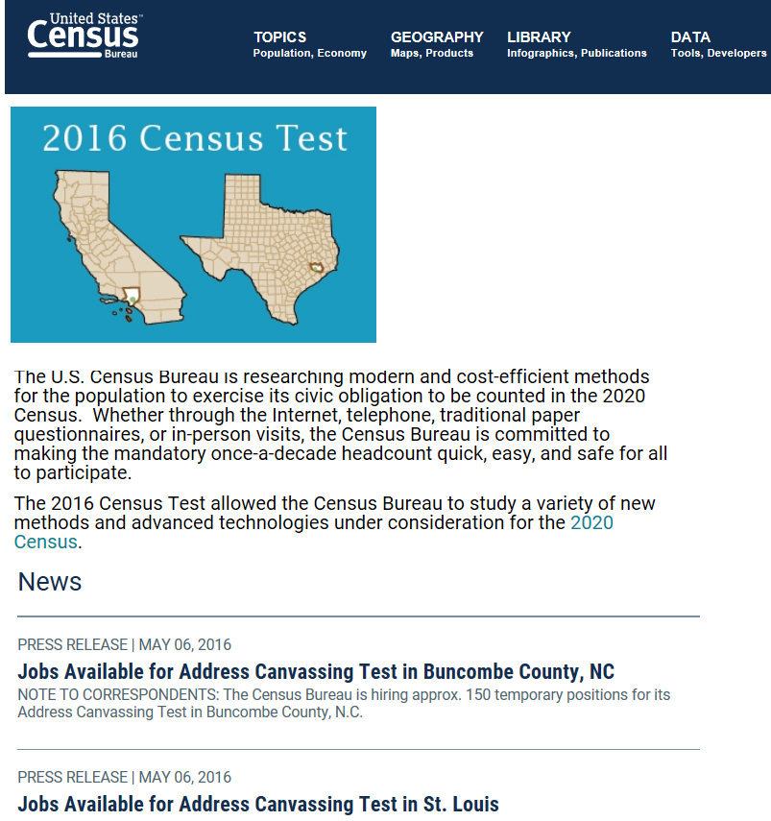
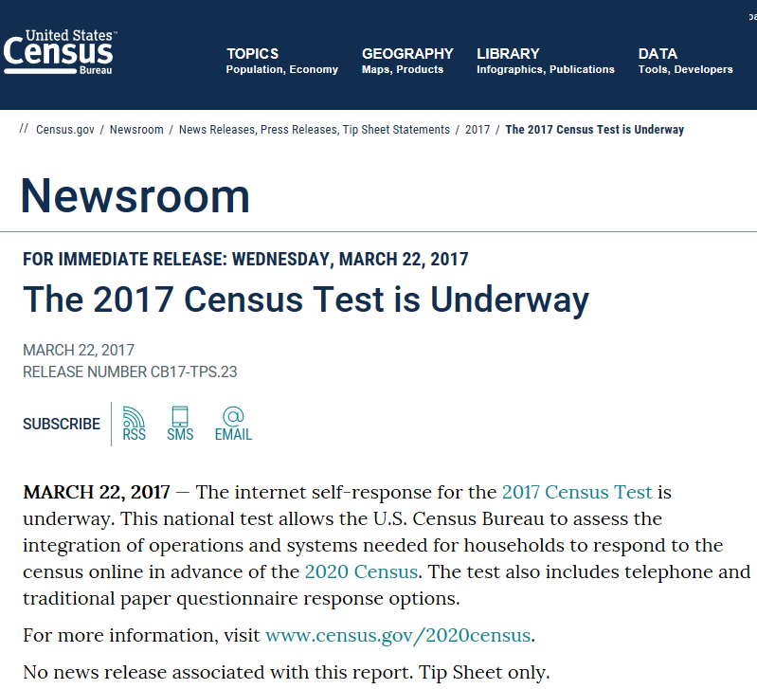
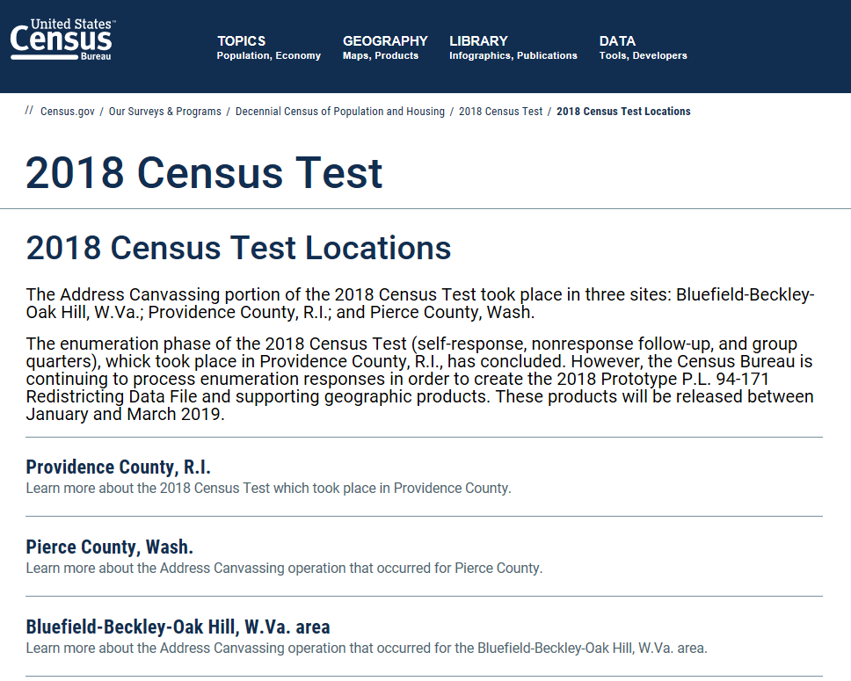
Operational Census Tests

Slide 12
The Survey Life Cycle
}
01
Survey Design
02
Frame Development
03
04
05
06
07
08
Instrument Development
Sample Design and Implementation
Data Collection
Data Editing, Imputation, & Estimation
Data Review, Analysis & Correction
Data Products & Dissemination
More Metadata
Effort Here
will
result
in
}
Less Effort Here

Slide 13
Thank You!
NIEM 2018 Face-to-Face Meeting
October 29th, 2018
Christopher Carrino
christopher.n.carrino@census.gov
301-763-4198

